Slide 1
Information Meeting and Registration Student Registration Deadline on CampDocs is October 28th, 2024 http://app.campdoc.com/register/tpcc/pryde112224

Slide 2
What is Rotary International
Organization of business and professional leaders united worldwide
Provide humanitarian service, encourage high ethical standards, help build goodwill and peace in the world
World’s first service club founded in Chicago, Illinois, in 1905
Over 1.2 million service-minded men and women belonging to nearly 27,000 Rotary clubs in virtually every nation in the world
Rotarians plan and carry out a variety of humanitarian, educational, and cultural exchange programs that touch people’s lives in their local and world community.

Slide 3
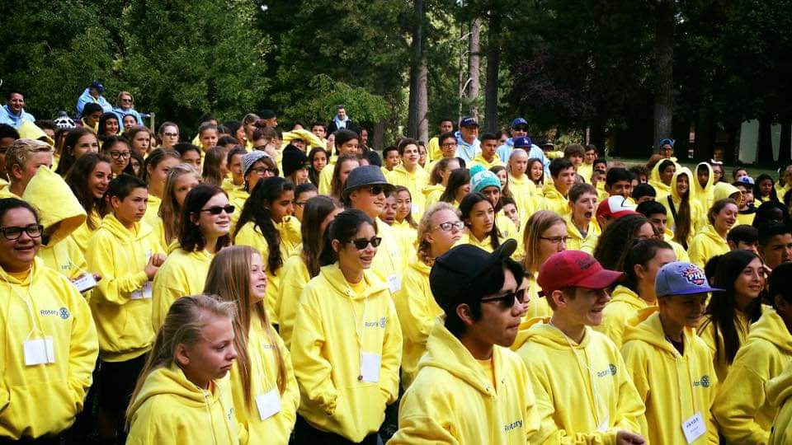
What is PRYDE? (Personal Rotary Youth Development Experience)
A leadership camp for 7th grade students who live or attend school in Rotary District 5330
Clubs in Riverside and San Bernardino Counties (Temecula, Menifee, Riverside, Peris, Hemet, San Bernardino, Yucaipa, Redlands, Palm Desert, San Jacinto, etc.)
Cost: $375; paid for by Rotary Clubs
November 23rd and 24th
Thousand Pines Conference Center, Crestline, CA.

Slide 4
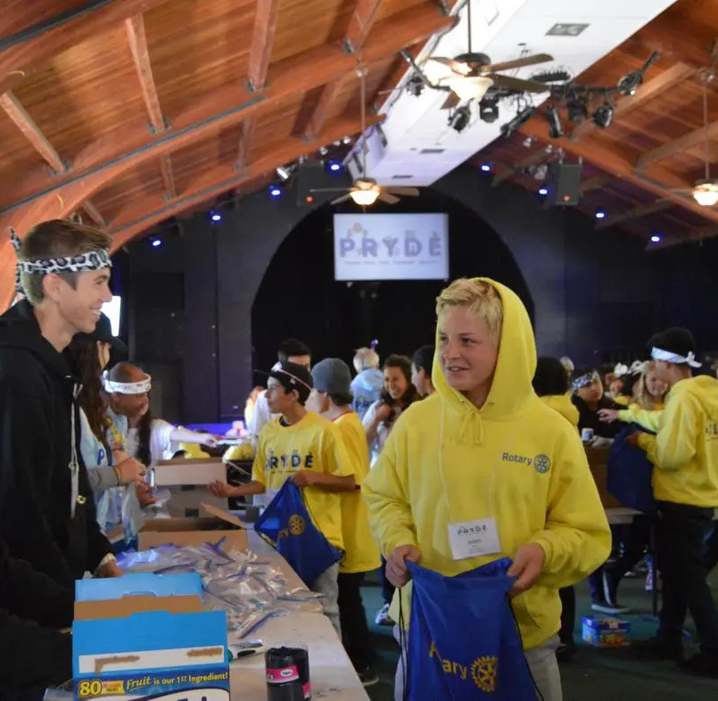
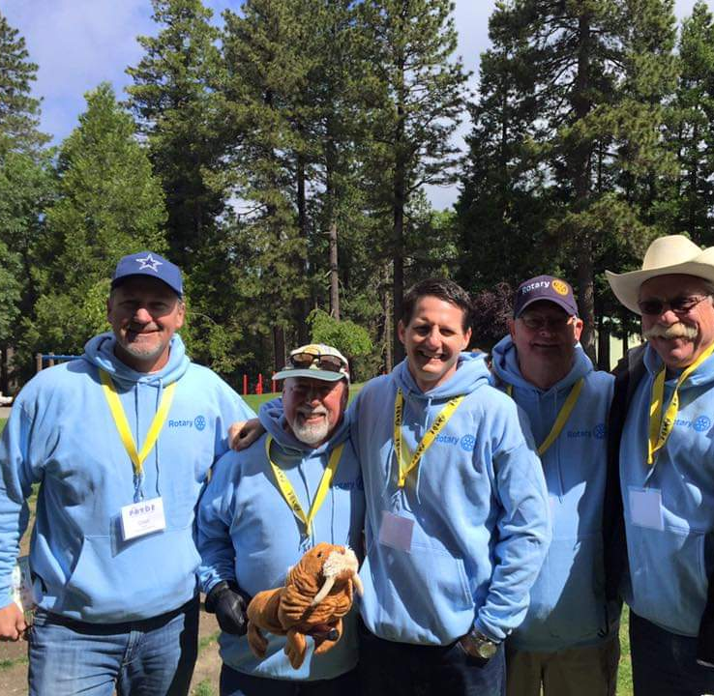
Who will be at camp?
Everyone over the age of 18 is live scanned
PRYDE Staff: 12 Volunteer Rotarians that ensure camp runs smoothly, from bussing, assigning student to cabins and groups, camp nurse, etc.
Tribal Elders: 20+ Rotarian volunteers who are assigned a group of 7-10 students
PRYDE Guides: 15-17 year old students who lead the 7th graders through teambuilding activities
PRYDE campers: 200 7th graders from District 5330

Slide 5
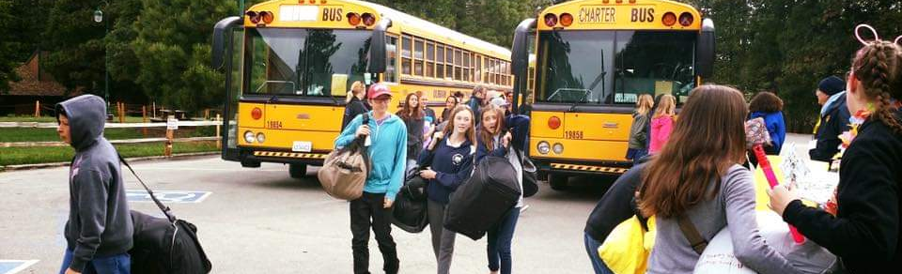
How Students Get To Camp
All students must ride the bus to camp and back from camp; and stay the entire time
Exact time and location student needs to be at the bus stop will be emailed at least a week prior to camp.
Be at the bus stop early on the morning of November 23rd
Students who miss the bus will not be able to attend camp
Students will return to the same bus location in the evening on November 24th
There will be a Rotarian from our club at the bus stop to check in our students

Slide 6
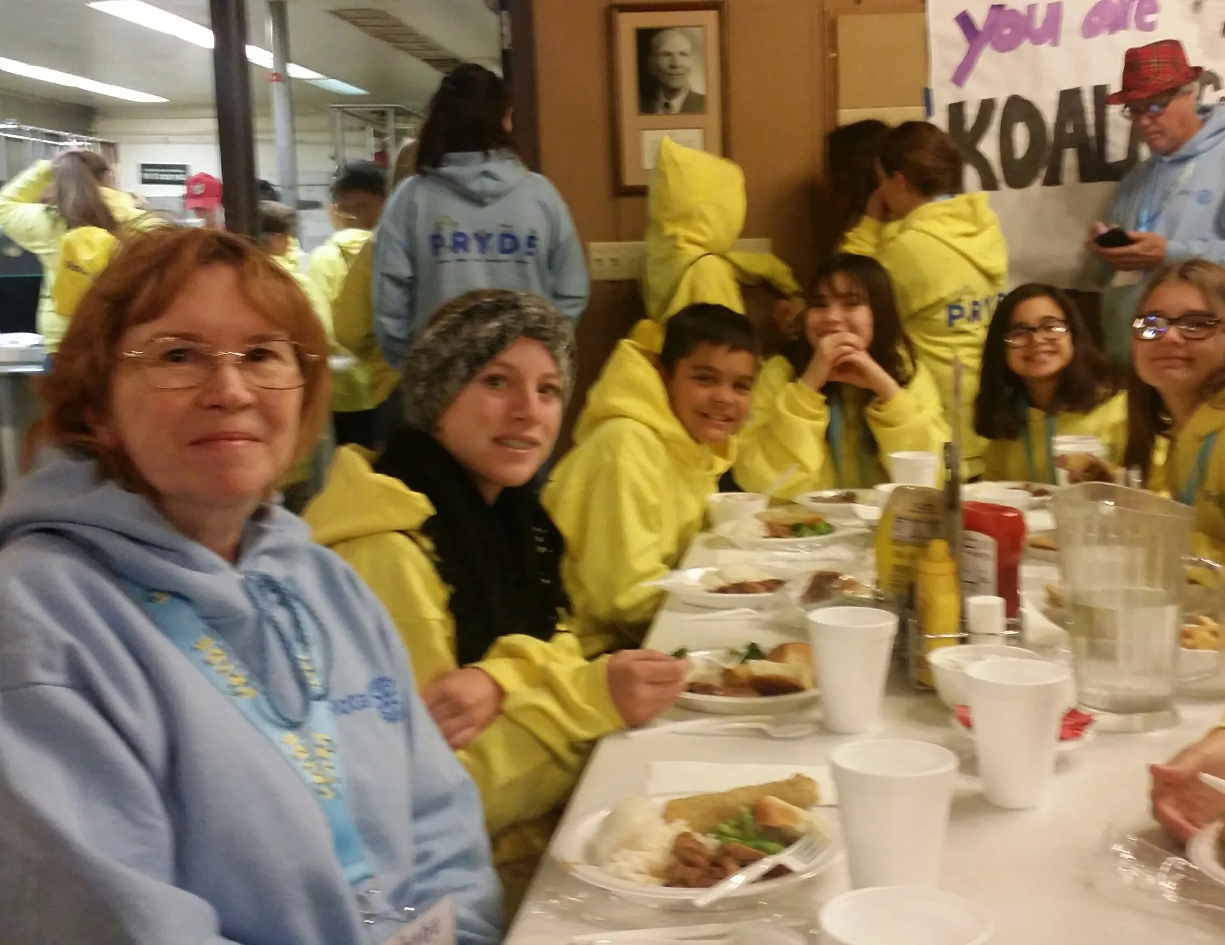
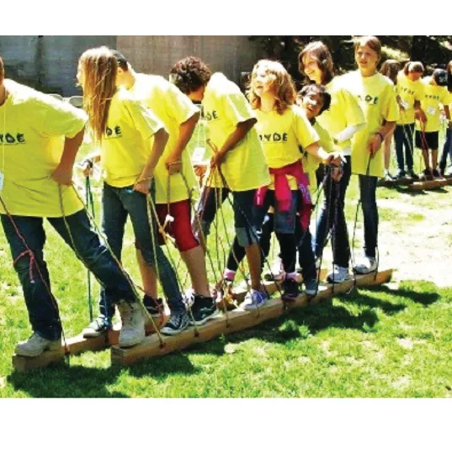
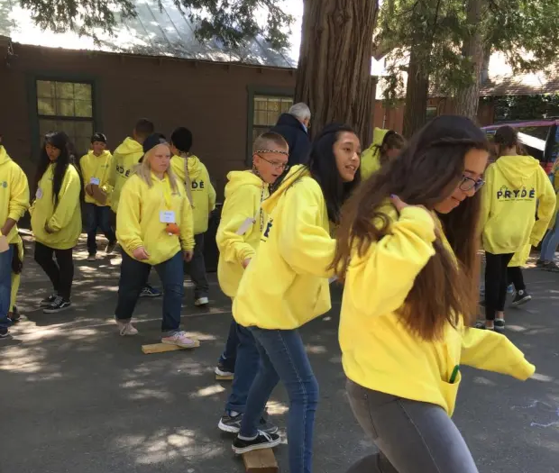
What students will do at camp
Leadership Speakers
Small discussion groups with a Tribal Leader
Recreation activities/team building activities
Eating: Lunch and Dinner on Saturday/Breakfast and Lunch on Sunday
Make sure camper eats breakfast on Saturday, lunch is not until noon
Notes:
You can use your phones to take pictures at camp, but please don’t use them for games, texting, or videos. We want you to fully join in on the activities!
Our club paid $375 for you to attend, so if you think you might have trouble staying engaged, please let us know so we can pick someone else.

Slide 8
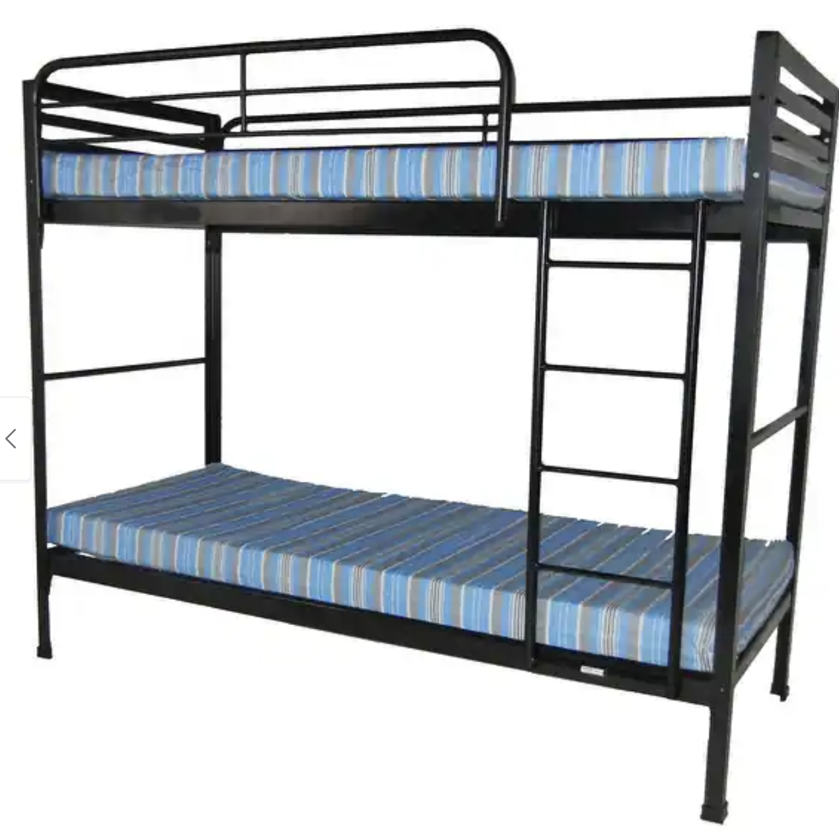
What To Bring To Camp
Sleeping bag and/or blanket
Pillow
Camera/phone
Flashlight
Toothbrush and toothpaste
Towels, washcloth, soap
Comb/brush
Medications if needed, need to go to the nurse
Sunglasses
Lip balm, hang lotion
Beanie/Gloves/Scarf
Non-slip shoes
Extra socks
Jacket/coat
Warm weather clothing
Cold weather clothing
Note for Parents and Students:
Students are limited to one small carryon/duffle bag and their sleeping bag due to limited bus space.
Be sure to attach an identification tag to your bag with your name, telephone number, and bus stop number.
Students must be able to carry these items on their own.
Students will be provided a PRYDE sweatshirt that MUST be worn the entire camp – there is no need to pack a lot of extra clothes.

Slide 9
PRYDE Camp Inclusivity Statement
Inclusive Environment: PRYDE is committed to creating an inclusive and supportive environment for all participants.
Volunteer-Led: Our camp is led by dedicated volunteers who strive to ensure a positive experience for every child.
Special Needs Consideration:
While we aim to accommodate all children, our volunteer resources may limit our ability to support every special need.
If your child has special needs, please inform/discuss this with your club representative who will advise camp leadership
We will work with the camp leadership to assess our ability to provide the necessary resources and support to ensure this camp is suitable for your child.

Slide 10
Food/Allergies/Medication
medication must be in their original bottles; medication will need to be taken to the nurse upon arrival. see Medication Guidelines listed on the back of the “What To Bring To Camp” for details
If you have any food allergies, please be sure to indicate them on your registration
Notes:
1. All medications must be put in a ziplock bag with the campers name on it.
This bag should be delivered to the camp nurse upon arrival at camp.
2. All medications must be in their original bottles with the medication name and
strength.
3. Prescription medications must have the original patient label on them.
4. All medications must have the camper’s name on them.
5. All prescription medications must have the dose (preferably in milligrams but
milliliters or puffs may be appropriate for some medications).
6. All prescription medications must have the dosing interval, e.g. twice a day,
every 8 hours, three times a day before meals, once a day before bed, etc.
7. If a medication is given only as needed, the reason for giving it must be
included, e.g. for seizures. If a camper has a sliding scale for insulin, the
scale must be included with the insulin.
8. All medications must be labeled with the total amount in the bottle, e.g. 6 pills,
50mL, etc.
9. Any medications that require additional delivery devices, such as needles
and syringes, nebulizer machine, spacer, etc., must have those devices
(properly labeled) along with the medications.
10. Medications that are not completely labeled cannot be administered for
safety and liability reasons.

Slide 11
Cell Phone Policy
Cell phones can be used to take pictures only
All other activities, texting, social media, playing games, watching videos, will not be allowed.
Students will be allowed to make and receive calls during allocated time.
Although you do not pay to attend PRYDE, a rotary club paid $375 for you to attend, if you think you might have trouble staying engaged and off your phone, please let us know so we can pick someone else to attend camp.

Slide 12
Reach Out If You Have Questions
If something changes and your child can no longer attend camp, please reach out ASAP so we can fill the spot with an alternate. Our club is paying $375 for your child to attend, if they no show at the bus, we lose the money and a kid loses the opportunity to experience camp.
ADD CLUB CONTACT INFORMATION HERE

Slide 13
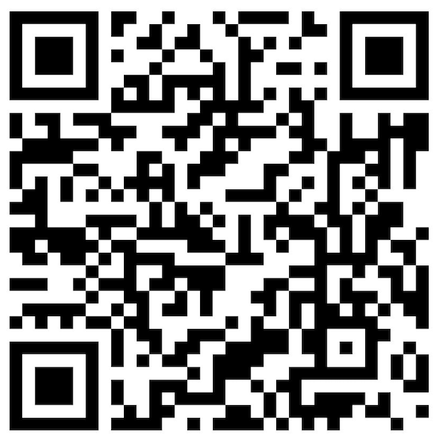
CampDocs Student Registration
Needs to be 100% complete by Oct. 28th to attend camp. You must answer all the questions.

